Slide 1


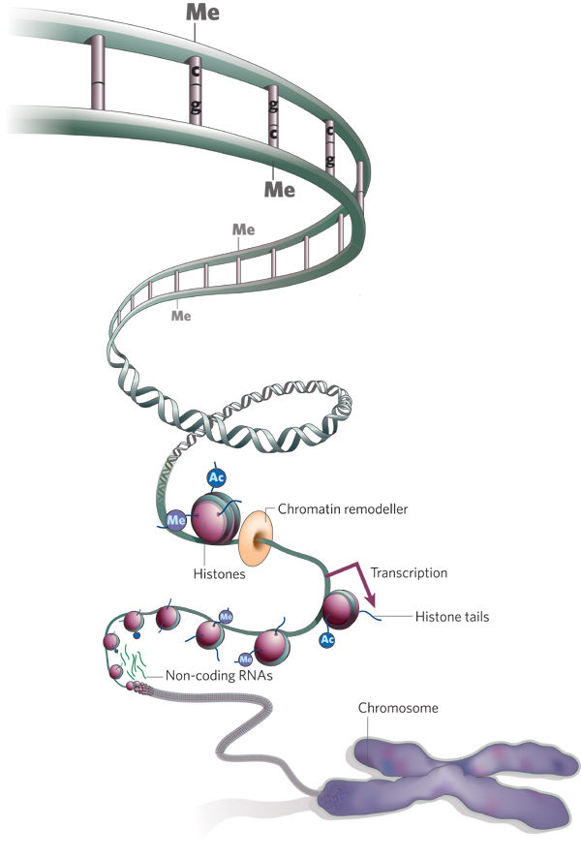

Slide 2
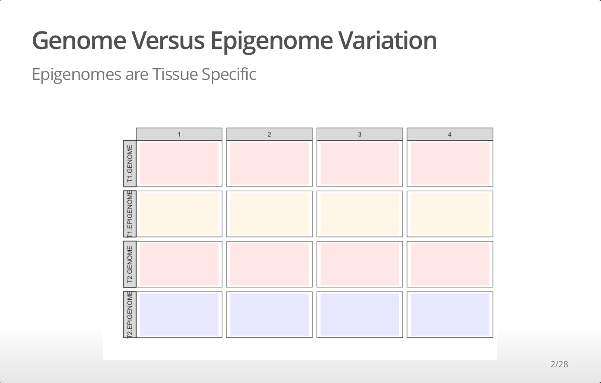
Tissue A
Tissue B

Slide 3
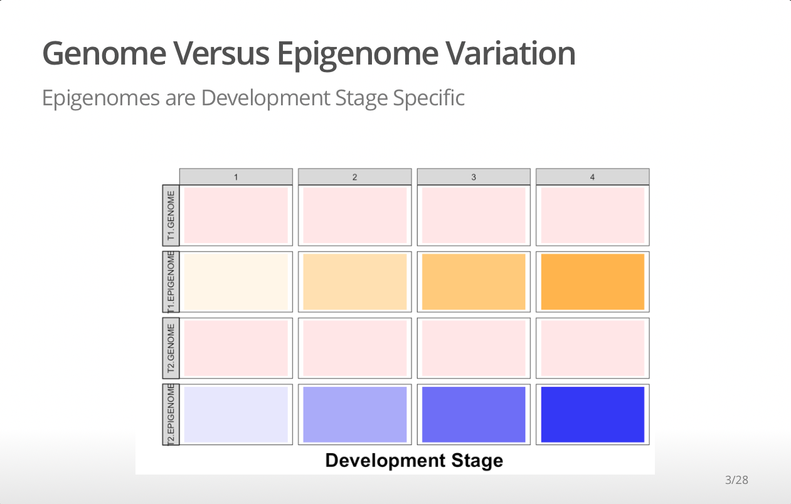
Tissue A
Tissue B

Slide 4
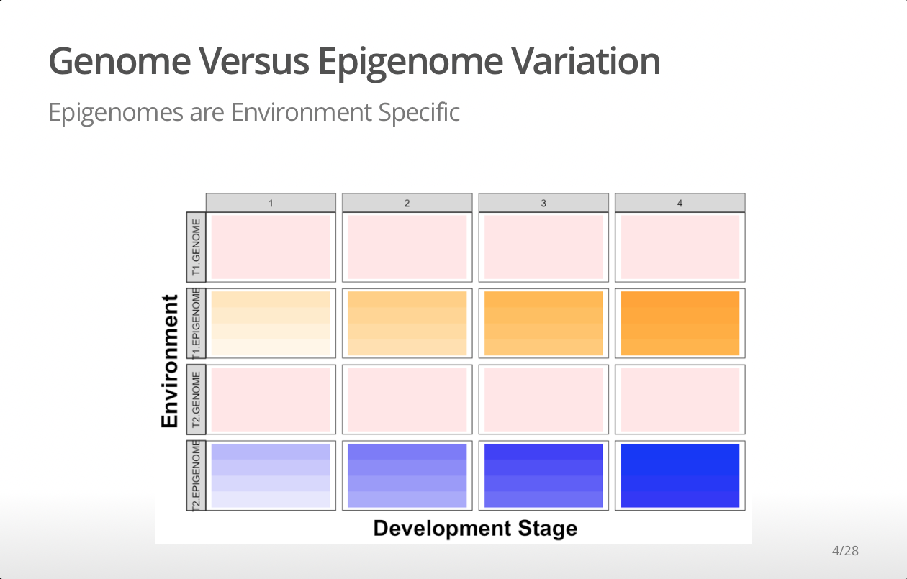
Tissue A
Tissue B

Slide 5
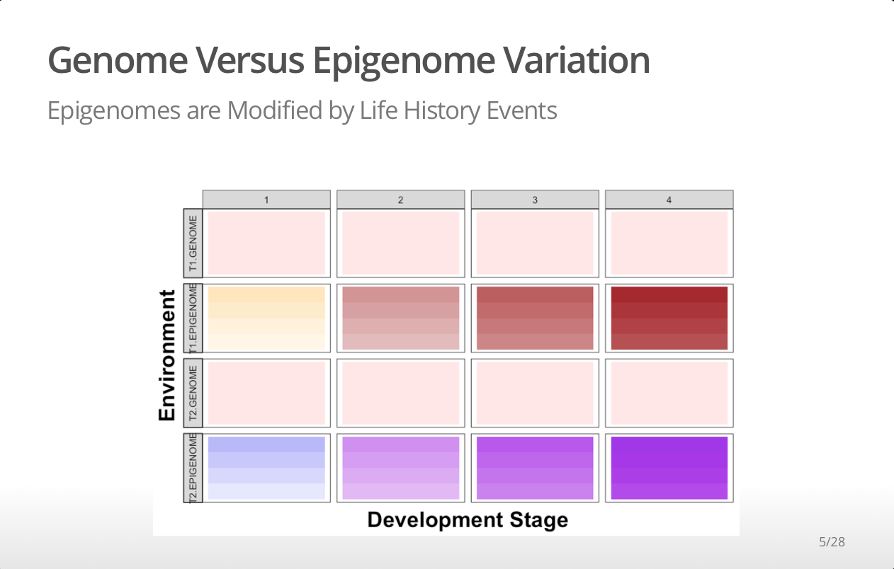
Tissue A
Tissue B

Slide 6
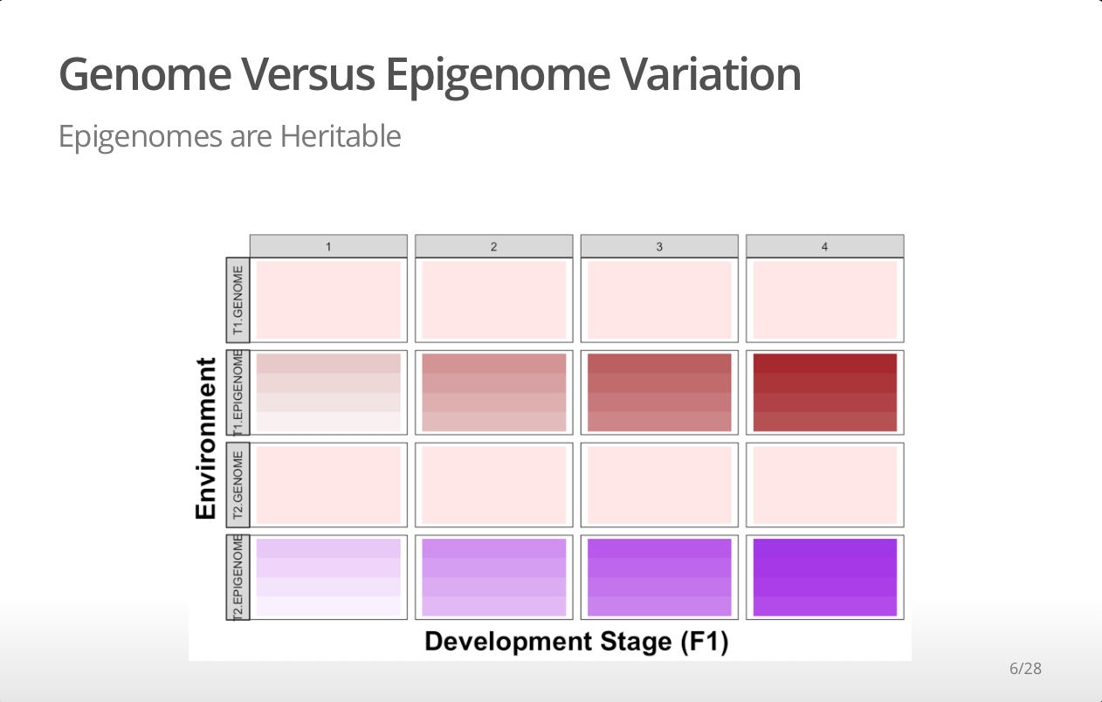
Tissue A
Tissue B

Slide 7
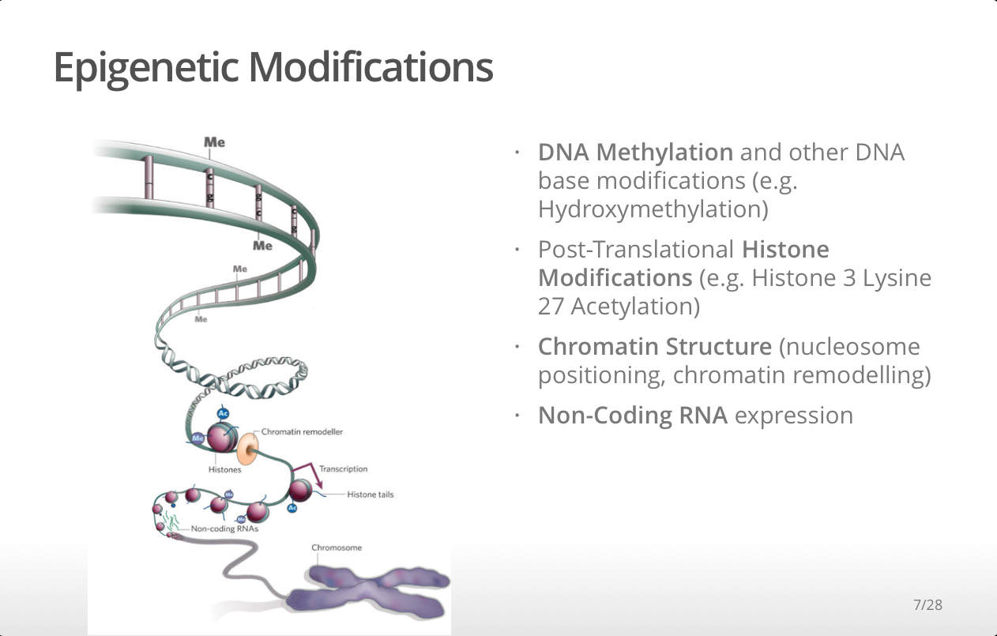

Slide 8
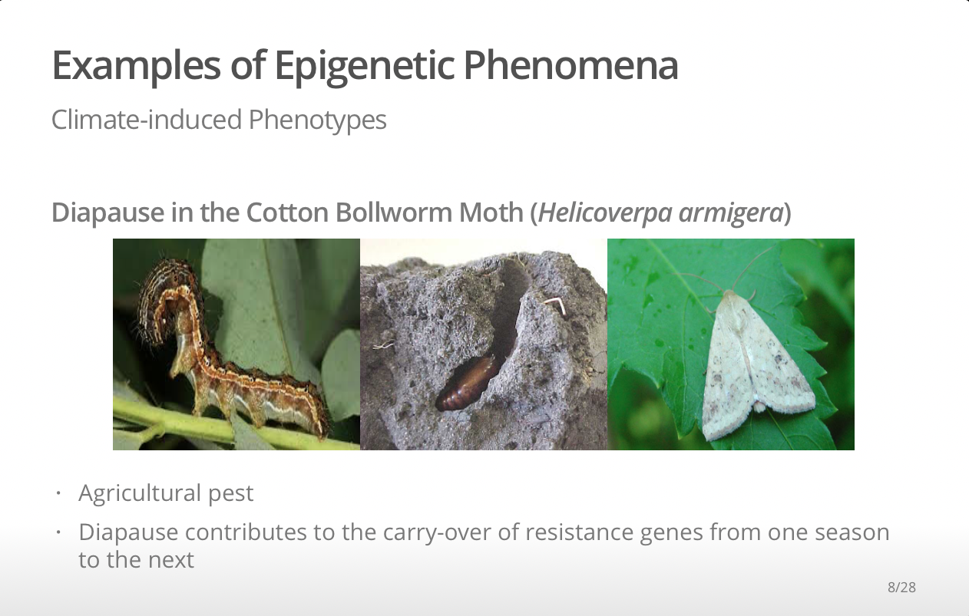
Jack Royle

Slide 9
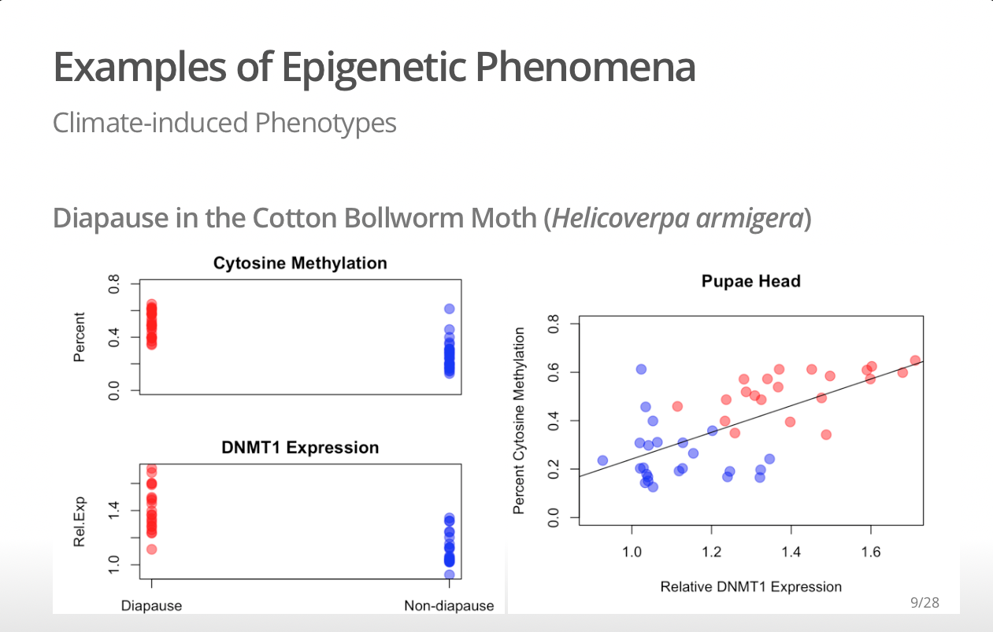

Slide 10
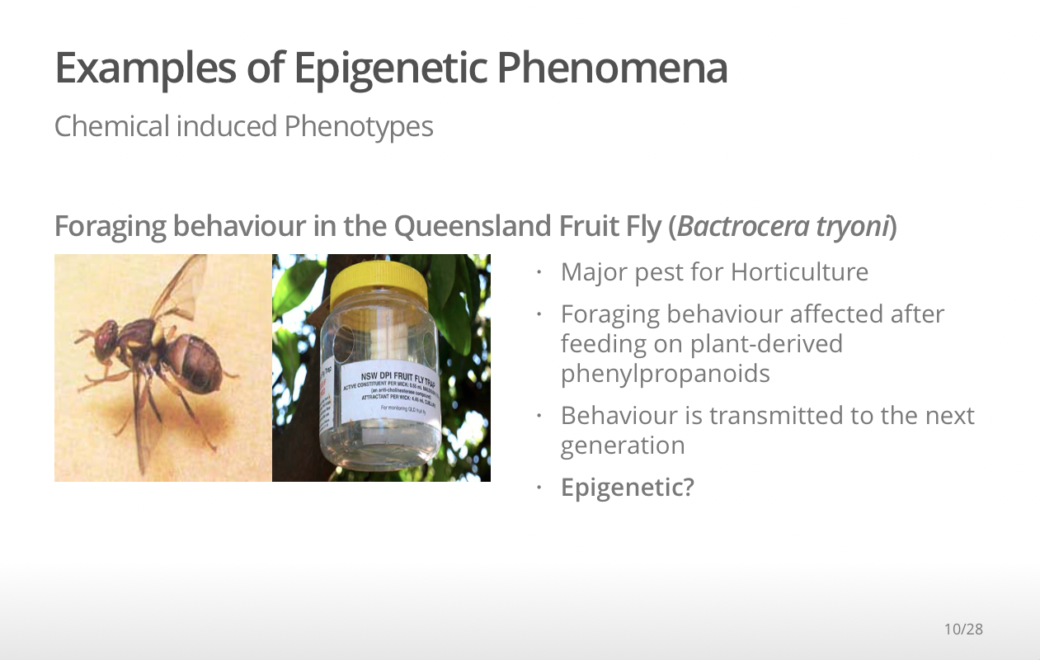
Kumaran Nagalingam

Slide 11
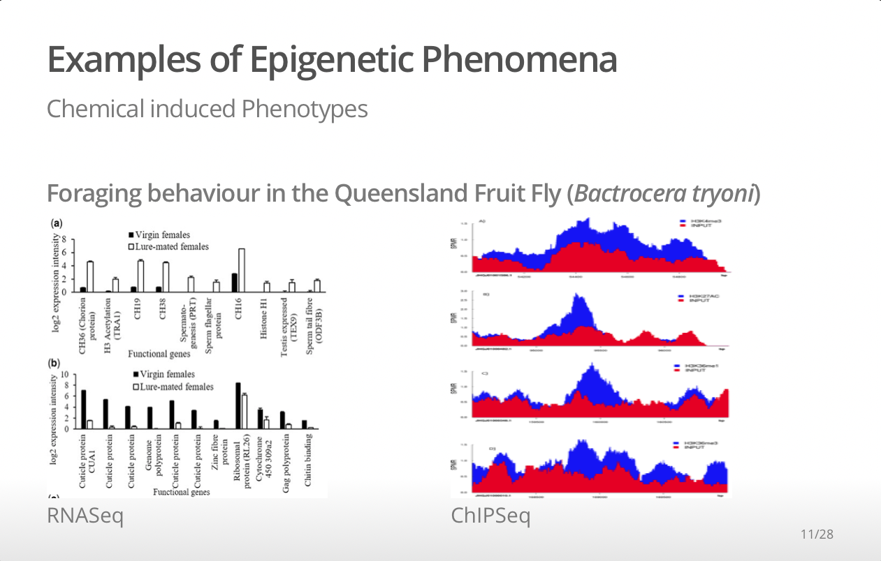
Kumaran Nagalingam
https://doi.org/10.1371/journal.pone.0194420

Slide 12


Slide 13
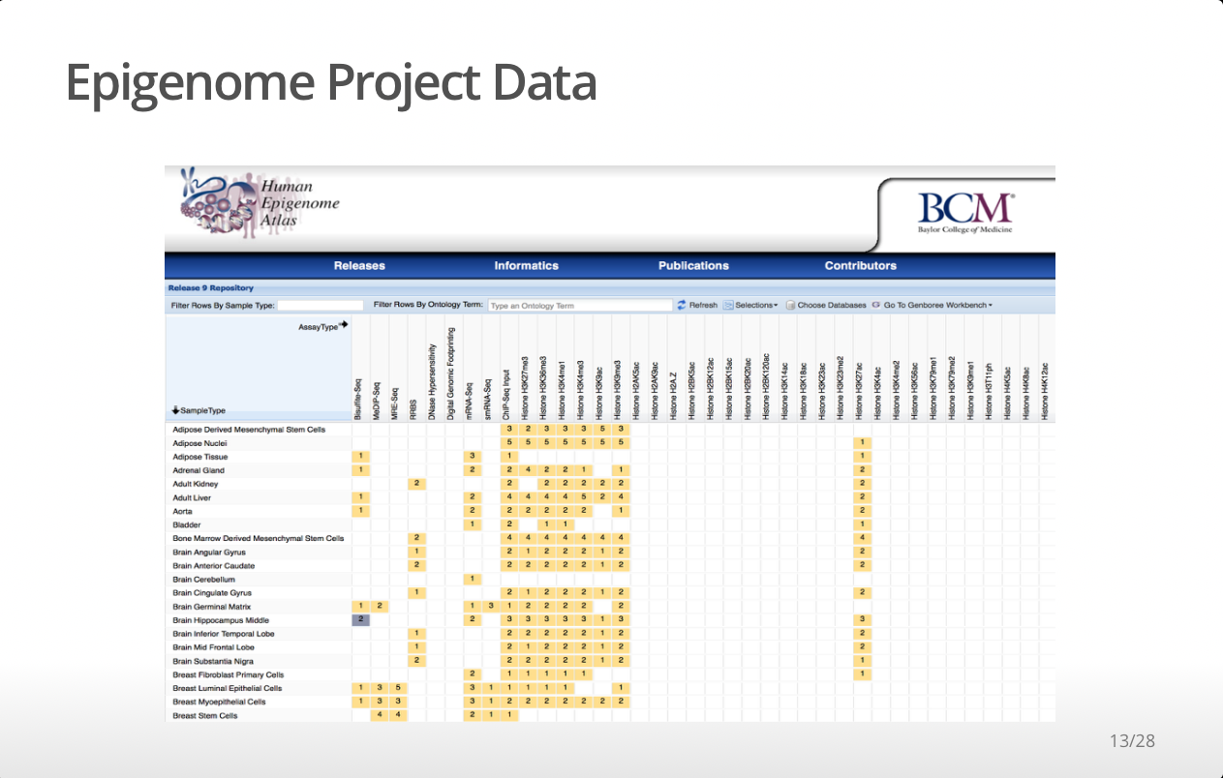

Slide 14
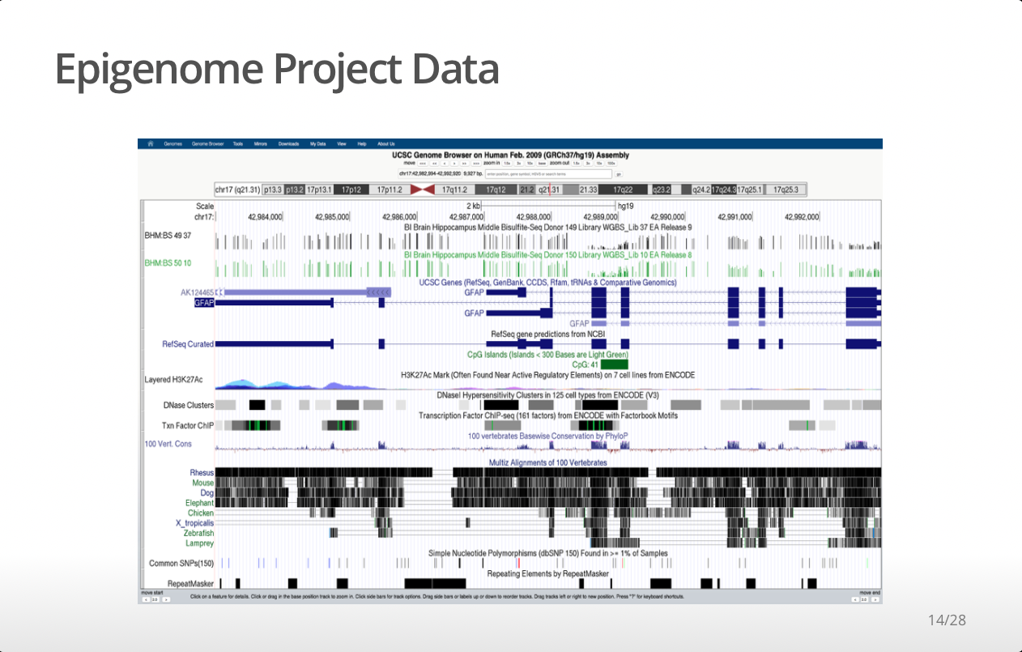

Slide 15
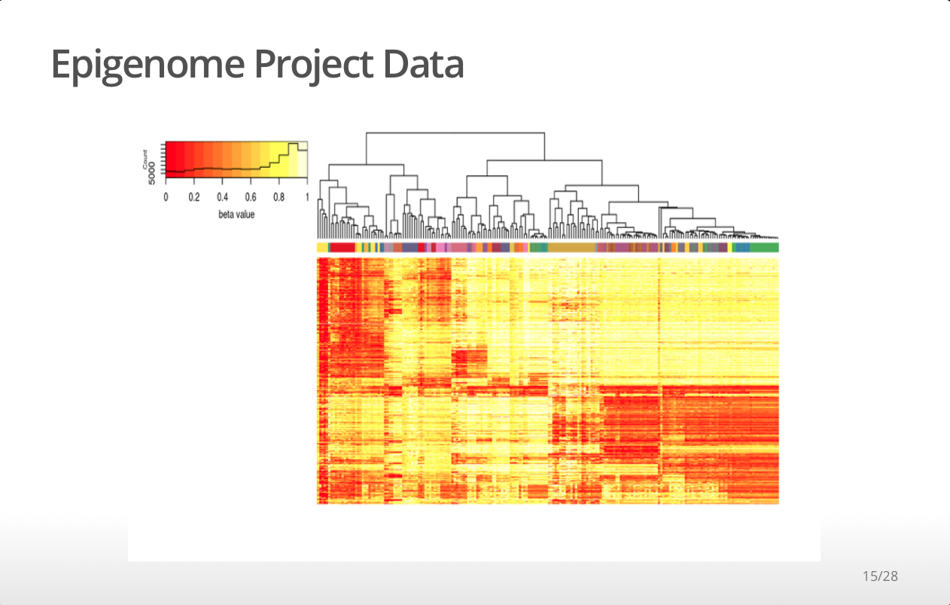
DeepBlue
10.1093/nar/gkw211

Slide 16
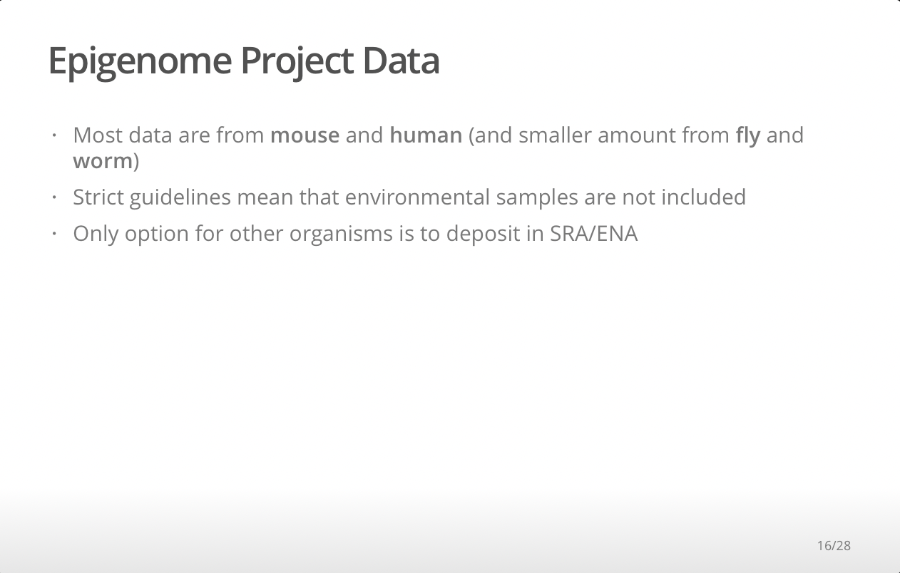

Slide 17
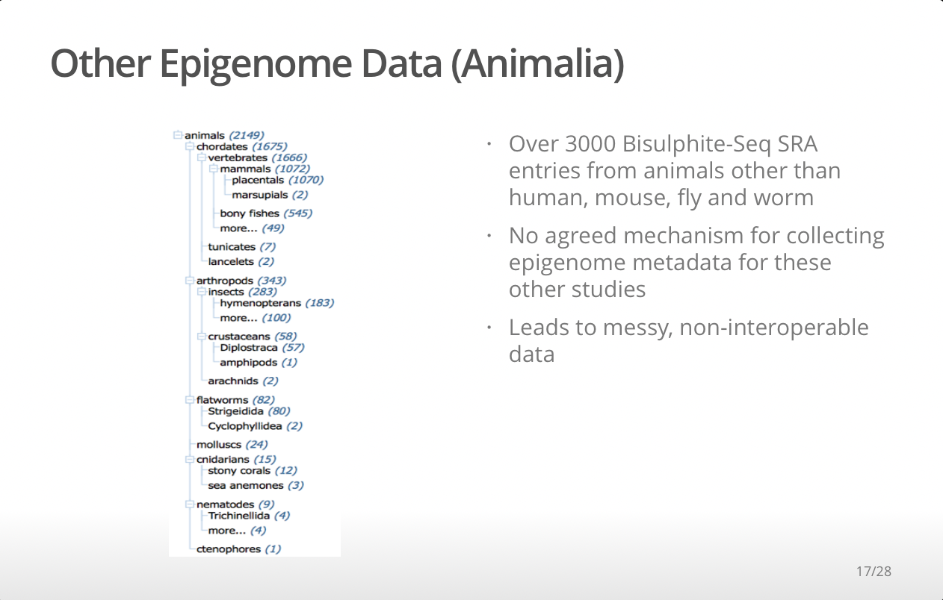

Slide 18
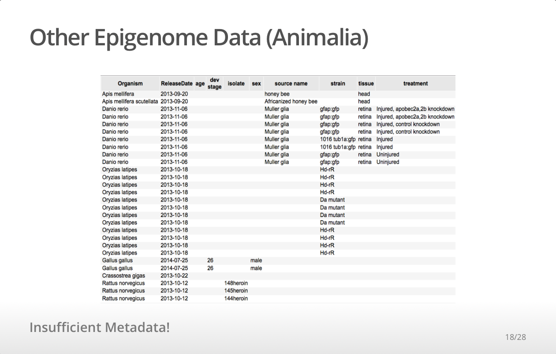

Slide 19
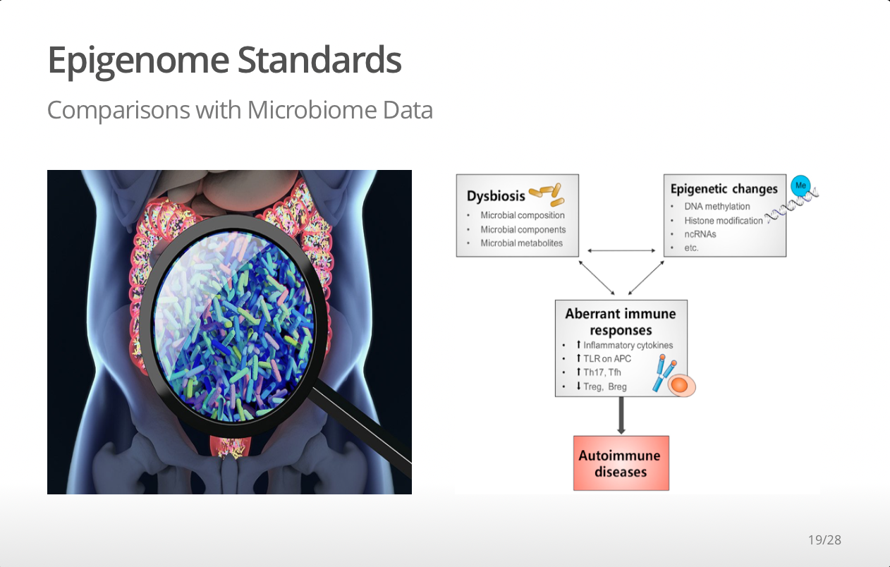
10.1016/j.jaut.2017.03.009

Slide 20
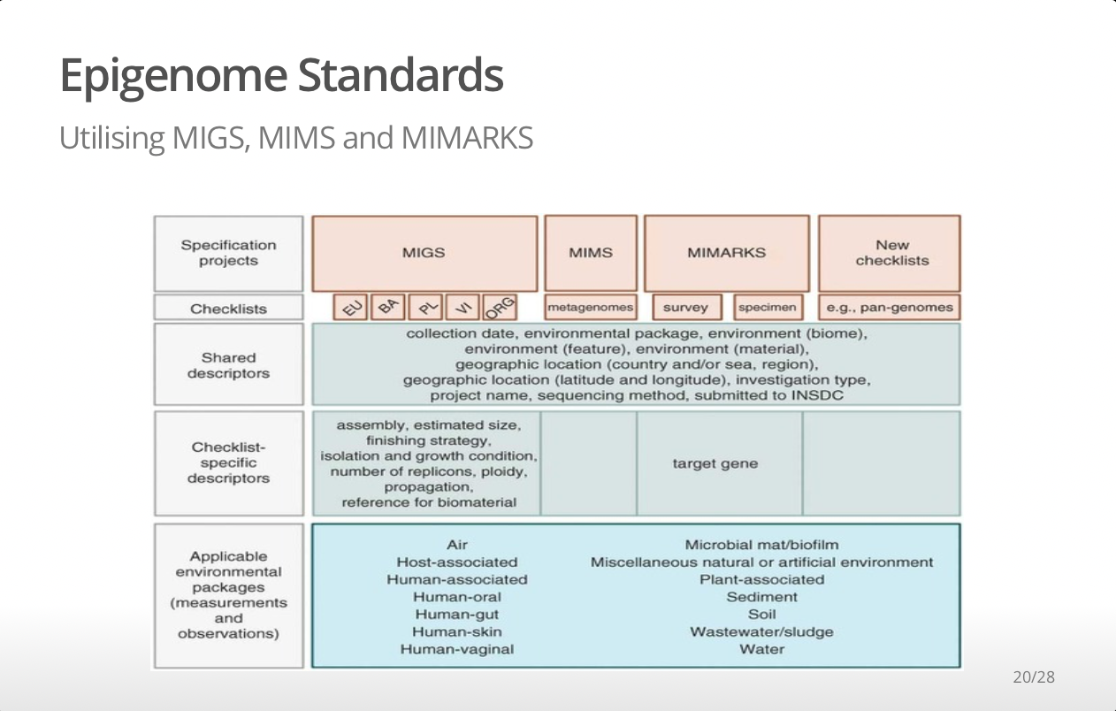
doi:10.1038/nbt.1823

Slide 21

10.1371/journal.pbio.2002925

Slide 22
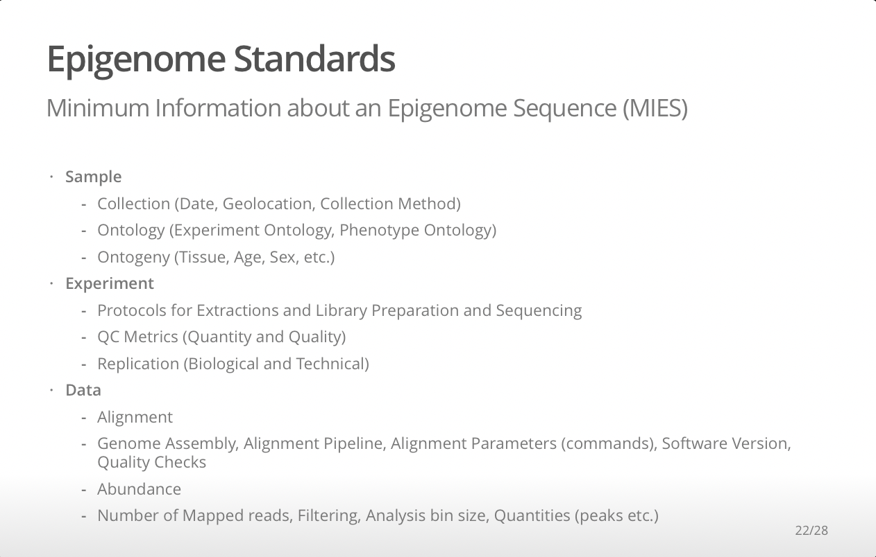

Slide 23
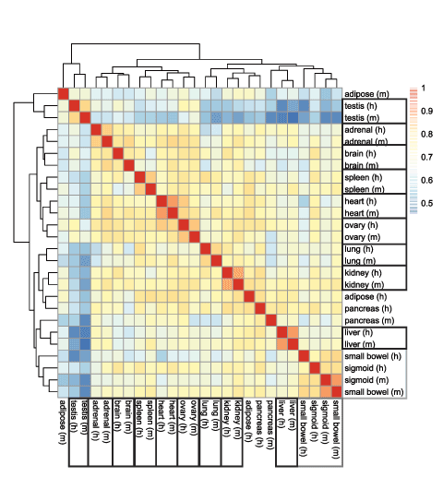
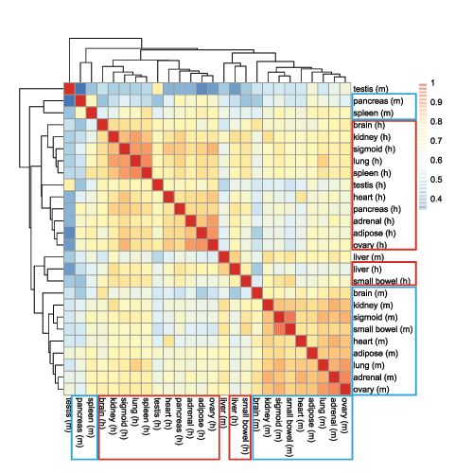
A reanalysis of mouse ENCODE comparative gene expression data (Yoav Gilad, F1000)

Slide 24
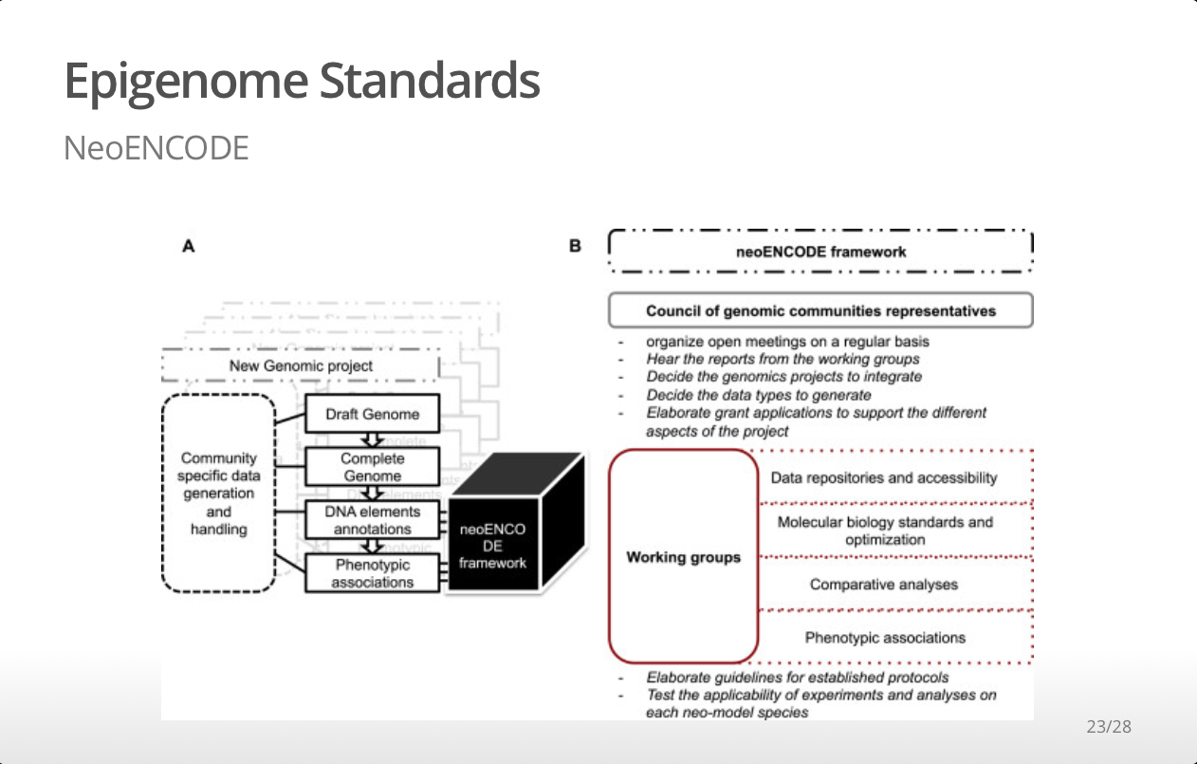
10.1186/1471-2164-15-490

Slide 25


Slide 26


